Slide 1
Weekly Scheduler
Created by: Stacie & Mark
With assistance from: Fanny

Slide 2
Challenges
The whole project
Massaging the data
Populating dates
Connecting User & Events with an id

Slide 3
Triumphs
Combining Mark’s user model
Refactoring the code to adjust events to the user model
Completing the MVP
Finishing the project!

Slide 4
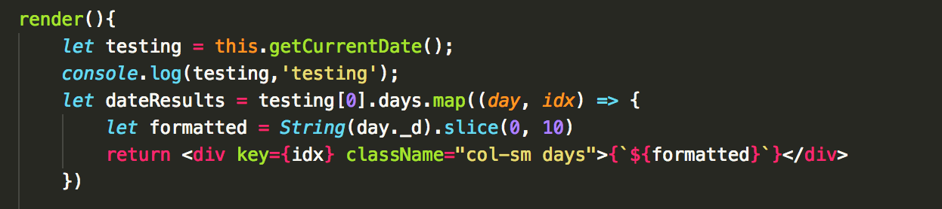
Outstanding Code

Slide 5
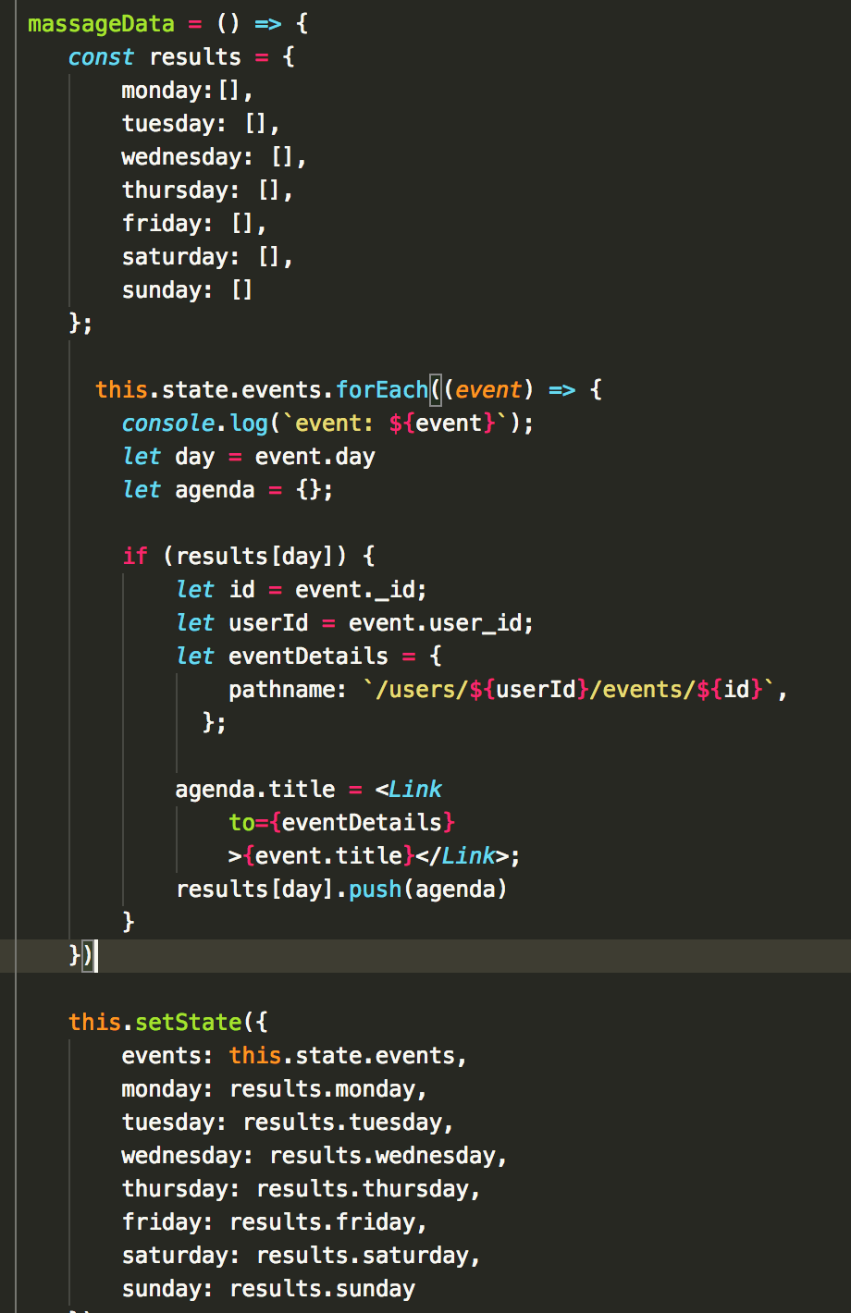
Outstanding Code

Slide 6
Shoutouts
Thank you Fanny
Thanks to Jacob for helping research Moment.js
Thanks to the class for the emotional support

